Slide 1
ANALYSIS and COMPARISON of EARLY-STAGE DIABETES RISK and DIABETES PREDICTION
Gadikoppula Pranavi Utkarshika Baidya

Slide 2
Diabetes
What is diabetes?
Types
What are the symptoms?
Diabetes is a common chronic disease that can be dangerous.
Diabetes is diagnosed when blood glucose levels are greater than normal, which is caused by increased insulin secretion or biological consequences.
Diabetes can disfunction tissues, kidneys, eyes and blood vessels. Diabetes can be divided into two categories.
Type 1: Occurs in younger people under the age 30.
Type 2: Occurs more commonly on middle-aged and old people,
Fatigue
Tingling
No healing
Weight lose

Slide 3
Proposed system
Our proposed system has 2 parts , early stage diabetes risk prediction and diabetes prediction and eliminating the risk of False Negatives Drastically.
In proposed System, we will use various Machine Learning Model/Algorithms to classify the Patients who are affected with Diabetes or not.
The dataset is classified into trained and test dataset where the data can be trained individually, these algorithms are very easy to implement as well as very efficient in producing better results and can able to process large amount of data.
Even for large dataset these algorithms are extremely fast and can able to give accuracy of about over 80%

Slide 4
WHY is this a good Problem to be solved?
•In 2019, diabetes was the direct cause of 1.5 million deaths.
-2000 and 2019, there was a 3% increase in age-standardized mortality rates from diabetes.
• In lower-middle-income countries, the mortality rate due to diabetes increased 13% [1]
More than 1 in 4 of them don’t know they have the disease.
In 2014, 8.5% of adults aged 18 years and older had diabetes [2]
People are unaware of the impact of the disease so they might not show interest to take a test though there are many traditional techniques they cost much this machine learning technique can reduce the cost and can save the life.
Diabetes is the majorly seen disease if proper treatment is not done for the disease then it results in several other health issues and also leads to death .
If it is predicted at early stage the cost of treatment can be reduced and can save life.

Slide 5
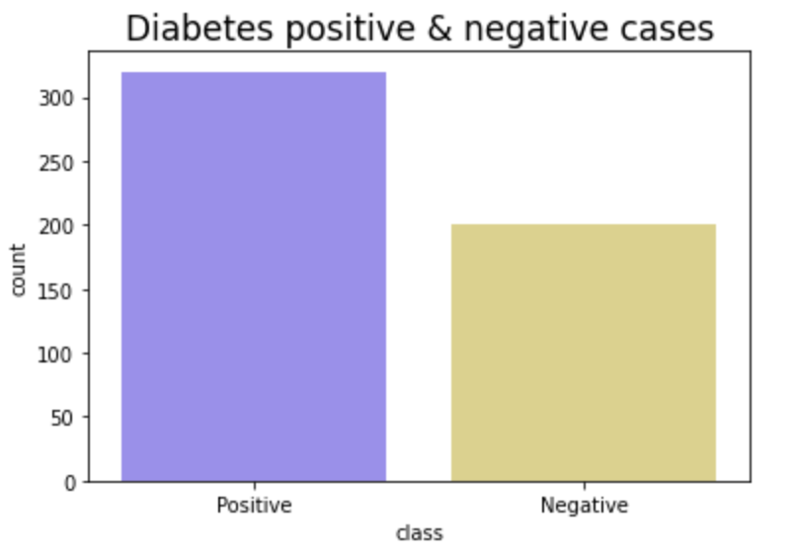
Project Details
Part 1
Early Stage Diabetes Risk Prediction
Project
Part 2
Diabetes Prediction

Slide 6
Algorithms Used
Early stage Diabetes Risk Prediction
DIABETES Prediction
Linear Regression
Decision Tree
Linear Support Vector Machine
Naive Bayes Classifier
K-Nearest Neighbour
Random Forest
Gradient Boosting Classifier
GaussianNB
DecisionTreeClassifier
SVC
RandomForestClassifier
LogisticRegression
KNeighborsClassifier
GradientBoostingClassifier

Slide 7
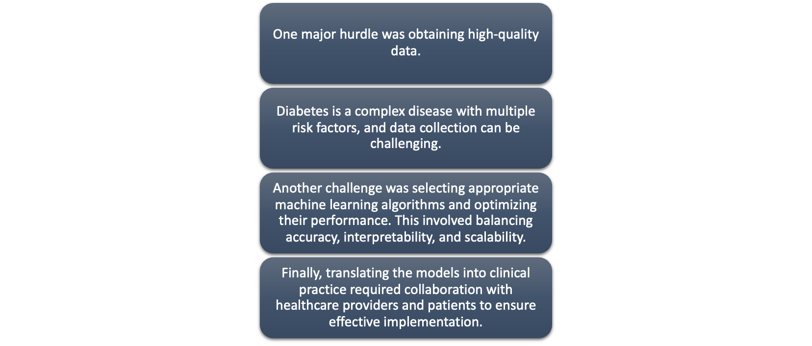
Major Hurdles

Slide 8
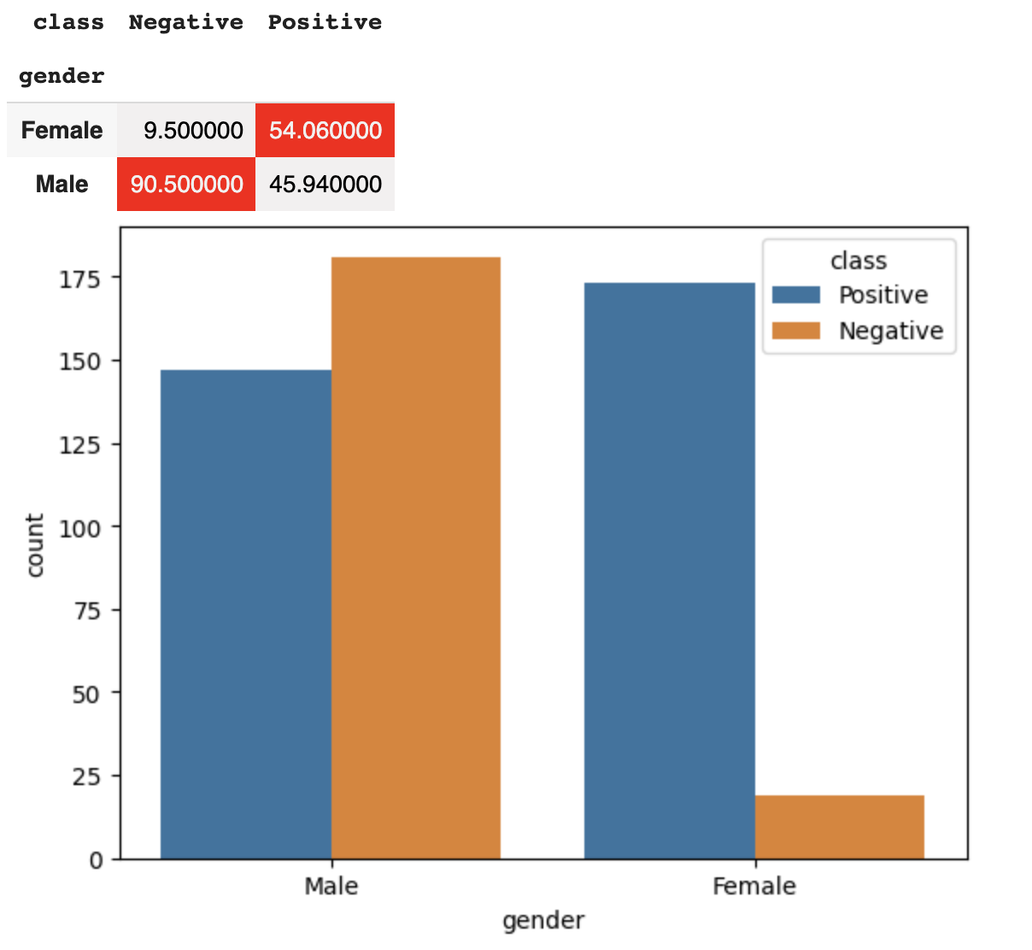
Interesting Finds
Female are found to be diabetic than male

Slide 9
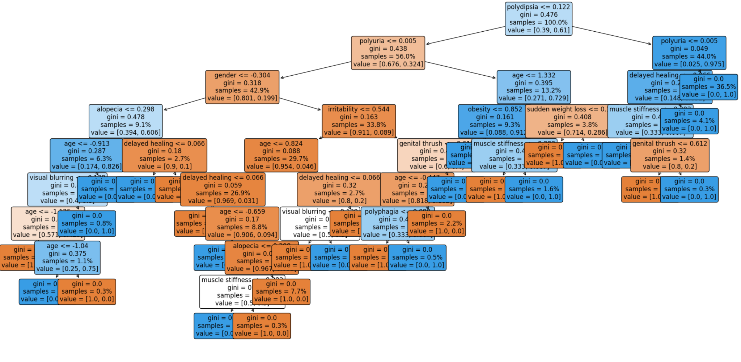
Interesting Finds
Decision tree performs well for early stage diabetes risk prediction
Notes:
Decision trees are simple and interpretable models that can be easily visualized and understood by clinicians or researchers who may not have a strong background in machine learning. They can provide insights into the important features that contribute to the risk of developing early stage diabetes.

Slide 10
Results
Early stage Diabetes Risk Prediction
Naive Bayes Classifier: 90.38%
K-Nearest Neighbour: 90.38%
Linear Regression: 92.31%
Linear Support Vector Machine: 95.51%
Decision Tree: 97.44%
Random Forest: 98.08%
Gradient Boosting Classifier: 98.08%
Best Model for this is Random Forest

Slide 11
Results
Diabetes Prediction
GaussianNB: 70.13%
LogisticRegression: 80.52%
DecisionTreeClassifier: 80.52%
KNeighborsClassifier: 82.47%
SVC: 82.47%
GradientBoostingClassifier: 84.42%
RandomForestClassifier: 87.66%
Best Model for this is Random Forest

Slide 12
Comparison and Result
Robustness to noise and outliers: Random Forest is a type of ensemble model that combines multiple decision trees, which makes it more robust to noisy or outlier data points that can affect the accuracy of other models.
Non-linearity: Random Forest can capture non-linear relationships between the features and the target variable, which is important in many machine learning applications, including diabetes prediction.
Feature importance: Random Forest can provide insights into which features are most important for predicting diabetes, which can be useful for understanding the underlying factors that contribute to the disease.
Easy to use and interpret: Random Forest is relatively easy to implement and interpret, compared to other complex models like deep neural networks, which can be helpful for clinicians or researchers who may not have a strong background in machine learning.
Notes:
Random Forest is one of the popular and effective machine learning models for diabetes prediction, but it may not necessarily be the "best" model for every situation. However, there are a few reasons why Random Forest is a good choice for diabetes prediction:

Slide 13
Conclusion
-could use the early stage diabetes risk prediction as a preliminary screening tool to identify individuals who are at a higher risk of developing diabetes.
-Once these high-risk individuals are identified, they could be targeted for more intensive monitoring and intervention to prevent or delay the onset of diabetes.
-Use machine learning model
-By linking these two models, healthcare providers can better target their resources and interventions
Notes:
It could be used to predict the likelihood of a high-risk individual developing diabetes within a certain timeframe, based on various risk factors and other relevant data.
towards those who are most likely to benefit from them, potentially leading to more efficient and effective diabetes prevention and management strategies.

Slide 14
Future Prospects
•In the future, we can further refine the models by incorporating more comprehensive and longitudinal data, including genetic, behavioral, and environmental factors.
•We can also explore new machine learning techniques, such as deep learning, reinforcement learning, and transfer learning, to improve accuracy and interpretability.
•Finally, we can evaluate the impact of the models on health outcomes and healthcare costs through rigorous clinical trials and cost-effectiveness analyses.

Slide 15
Reference
[1] https://www.paho.org/en/topics/diabetes#:~:text=In%202019%2C%20diabetes%20was%20the%20direct%20cause%20of%20284%2C049%20deaths,age%20of%2070)%20from%20diabetes.
[2] Ayele BH, Roba HS, Beyene AS, Mengesha MM. Prevalent, uncontrolled, and undiagnosed diabetes mellitus among urban adults in Dire Dawa, Eastern Ethiopia: A population-based cross-sectional study. SAGE Open Med. 2020 Nov 20;8:2050312120975235. doi: 10.1177/2050312120975235. PMID: 33282310; PMCID: PMC7686592.

